Slide 1
GUIDELINES Production Practice Survey

Slide 2
Production Practices Survey
Generate data-based EVIDENCES about current crop production practices
Derive better INSIGHTS for informed decision making

Slide 3
Production Practices Survey
Survey Methodology (25%)
Data Collection (45%)
Data Analytics (25%)

Slide 4
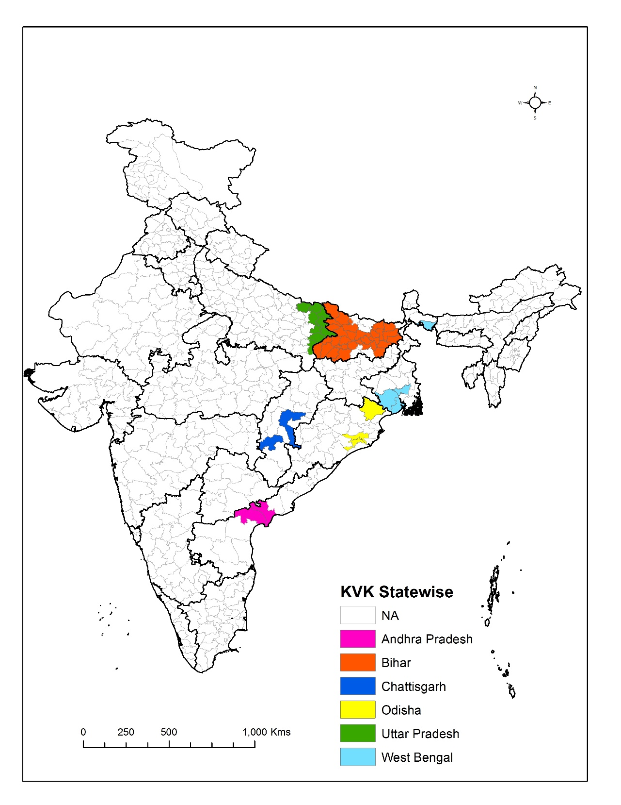
By 50 KVKs in 2018

Slide 5
Production Practices Survey
Survey Methodology
Data Collection
Data Analytics

Slide 6
Context
Wide geographical coverage
Various objectives, institutions,
technologies,
partners and stakeholders
Works with male and female farmers
New Varieties, sustainable management technologies
Building partnership: Targeting farmers through trials, demonstrations, training, various strategies of extension
Creating enabling environment (identifying change agents, linking markets, service providers, addressing policies)
GOAL
WHAT
HOW
Large scale use: markedly increase the staple crop yields and incomes of millions of farm families in South Asia

Slide 7
Partner
ZT,
ESW
Service provider
Service provider
Service provider
Partner
ZT, ESW
DSR, MTR
Service provider
DSR, MTR
Partner
Partner
Demonstration
Trial
Training
Service Provider
Farmers
Input Dealers
Partners
Service provider
Service provider
DSR, MTR
CSISA
Service provider
Service provider
Partner
ZT, ESW
Service provider
DSR, MTR
Service provider
Service provider
Partner
DSR, MTR
Partner
Partner
Service provider
Partner
Service provider
Service provider
ZT, ESW
DSR,MTR
Partner
ZT, ESW
Partner
Service provider
Service provider
Service provider

Slide 8
Spread
of technologies

Slide 9
Understanding the spread
Different technologies have different levels of adoption and spread
Same technology within same region shows different levels of adoption
Preferences
Perceptions
Experiences

Slide 10
Understanding the spread: Do we Know
What is the spread of technologies we are working with
What is the level of adoption
What is the growth trend
Who is using the technology
Where it has spread/not spread

Slide 11
Understanding the spread: Why do we need to Know
Pragmatic data – showing real use of technology
It gives data based evidence about technology
Internal learning
Proper targeting
Sharpening strategy and planning
External reporting

Slide 12
Understanding the spread: Major issues
How much can we collect?
Trials, demonstrations
Training numbers: farmers, types of trainings
Service providers: types of services, machines
Technology use: No of farmers, Hectares
How can we quantify the benefits?
How do we capture the feedback?

Slide 13
KVK engagement
To generate data-based evidence: better planning & technology targeting
To create a system of digital data collection: real time data, quick learning
To ease reporting obligations & sharpen feedback mechanisms

Slide 14
The framework and the process
Step 1: What
1. List of interventions, technologies and activities BY SEASON
Step 2: How
1. Understanding data sources: direct counting and use of inferences
Step 3: Who
Responsibility:
1. Lead person
1. Activity plans
2. Time Line
3. Reporting
Step 4: When
2. Discuss appropriate data collection procedure: sampling methods, survey types, tools required
3. Discuss data aggregation
2. Identify Indicators: what to capture
3. Identify data source related to specific topic
2. Developing team: identification of skill sets within the team
3. External resources if required
4. Task and roles

Slide 15
Framework
Type of survey: Data collection from farmers by household survey
Sample: 210 households
From 30 villages selected randomly
From 7 households from each of these 30 villages
Data collection tool: Open Data Kit (ODK)
Data aggregation: Extraction of compiled data from ODK server; analysis in Excel, R
Data analysis: Descriptive statistics, random forest

Slide 16
Random sampling: important terms
Element (or observation unit): unit about which information is sought (e.g. farm household)
Sampling unit: element available for selection at a given stage in the sampling process; usually, villages in the first stage and farm households in the second stage of the random sampling procedure
Sampling frame: list of sampling units available for selection
Population (or universe): aggregate of all the elements, as defined prior to selection of the sample

Slide 17
Random sampling: steps involved
Step 1: Define the population
Step 2: Select a sampling procedure
Step 3: Construct the sampling frame(s) required
Step 4: Determine the sample size
Step 5: Select the sample
Golden Rule in random sampling:
Each and every element of the population must have the same chance of being selected!

Slide 18
Random sampling: defining the population
Population is defined in terms of (possible definitions in parentheses):
Elements (farm households)
Sampling units (villages first, then farm households)
Extent (selcted districts of the selected states)
Time (Survey represents situation after Kharif season 2018)

Slide 19
Cluster sampling – Stage 1
For the district, compile a complete list of villages; this is sampling frame for Stage 1 of the cluster sampling procedure.

Slide 20
Cluster sampling – Stage 1
From the list of villages, randomly select an appropriate number using the PPS method (see below); easy-to-use functions for random selection available in MS Excel*.
* =randbetween(min,max)

Slide 21
The PPS method for village selection
Probability-proportionate-to-size‘ (PPS) method permits an equal number of HHs to be selected per village → logistical advantages!
Probability of a village to be selected must be proportionate to its size to fulfill the ‚Golden Rule‘. Example:
Village | Number of households (HHs) | Cumulative number of HHs | HH ID intervals | Probability of selection through random number
A | 200 | 200 | 1 -200 | 200/1000 = 20%
B | 300 | 500 | 201 – 500 | 300/1000 = 30%
C | 100 | 600 | 501 – 600 | 100/1000 = 10%
D | 400 | 1000 | 601 – 1000 | 400/1000 = 40%
Generate random number within the range 1 – max. HH ID (1000 in the example); a village is selected if the random number falls within its HH ID interval (thus making selection PPS).
Prerequiste: village sampling frame includes info on number of HHs!

Slide 22
Sampling Steps
Selection of villages in a district: Example of Begusarai, Biahr
Applying PPS on census data 2011

Slide 23
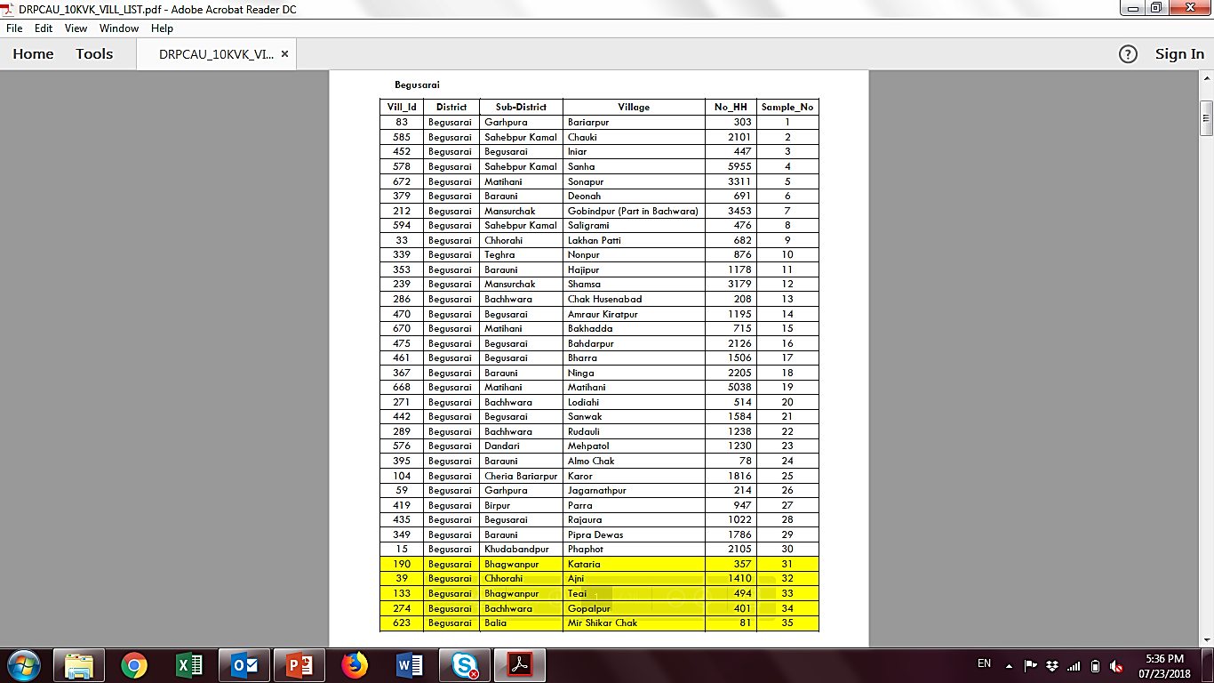
Result of PPS – Villages Selected

Slide 24
Cluster sampling – Stage 2
For the selected villages, compile a list of all resident households; this is the sampling frame for Stage 2 of the cluster sampling procedure.

Slide 25
Cluster sampling – Stage 2
From the lists of households, randomly select an appropriate number (again using MS Excel).

Slide 26
Sampling of Household

Slide 27
Sample size
The larger the sample, the more precise is the estimates of the underlying population (e.g. average rice yield, % farmers using mechanical transplanting in the district).
BUT: Gain in precision decreases quickly at the margin.
Recommendation: 210 randomly selected farm households spread across 30 randomly selected villages in your district.
Good balance btw precision and cost of data collection.

Slide 28
Sampling Steps
Selection of HHs in a village: Example of Bariayarpur
Applying simple random sampling to generate house numbers

Slide 29
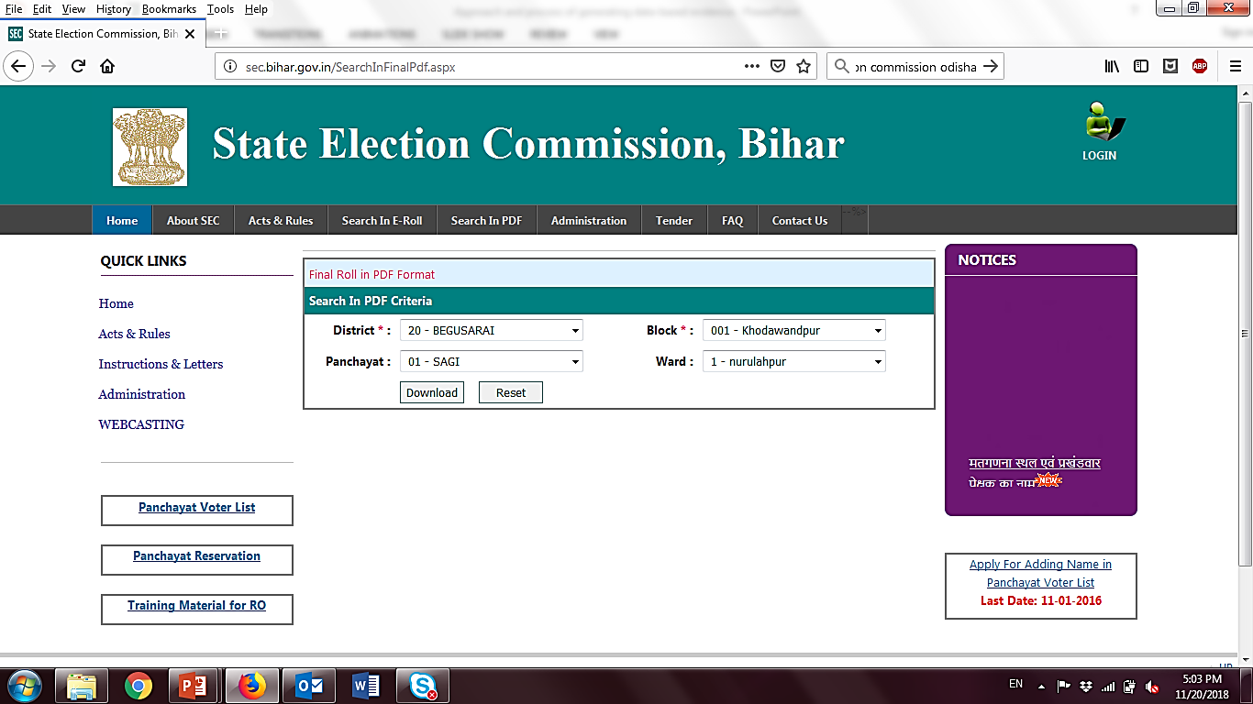
Sampling Steps

Slide 30
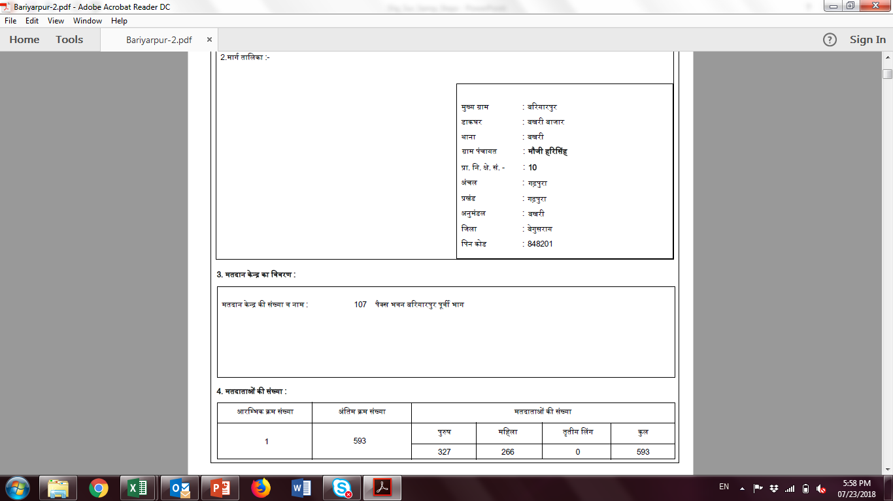
Sampling Steps
Identifying & surveying identified HHs
Referring to voter list of identified village

Slide 31
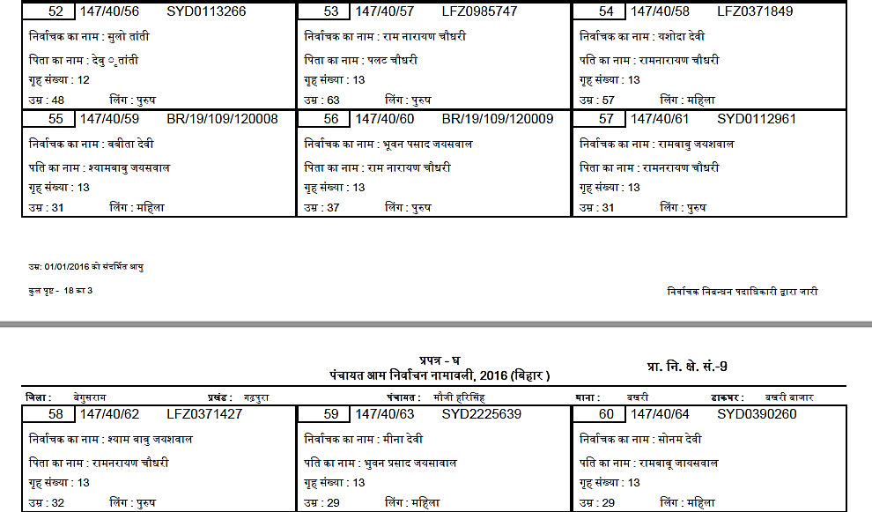
Sampling Steps
Sampling suggests – Ram Narayan Chaudhary is the selected farmer for survey.

Slide 32
Sample size
The larger the sample, the more precise is the estimates of the underlying population (e.g. average rice yield, % farmers using mechanical transplanting in the district).
BUT: Gain in precision decreases quickly at the margin.
Recommendation: 210 randomly selected farm households spread across 30 randomly selected villages in your district.
Good balance btw precision and cost of data collection.

Slide 33
Key points to capture from survey
1. Household economics and market information
Name of the household head
Name of the respondent, sex, mobile no.
Social category, Educational status
Household members – engaged in agriculture
Share of crop production marketed, selling price
2. Landholding characteristics
Operational land holding
Area of largest cultivated plot

Slide 34
Key points to capture from survey
3. Site characteristics and crop establishment
Soil texture, drainage class, perception on soil quality
Previous crop – tillage type, harvest date, residue management
Crop variety – type, establishment method, date, decision
Land preparation – type
Crop establishment method
Source of seed, amount planted, reason for delayed planting if any

Slide 35
Key points to capture from survey
4. Fertility management
Organic compost, total amount
Mineral fertilizer
Fertilizer application – planting, top dressing, Days after sowing
Source of information on fertilizer use
Source of fertilizer purchase
Availability

Slide 36
Key points to capture from survey
5. Irrigation management
Irrigation availability, source
Irrigation application: growth stage, number of times
Decision on irrigation
Source of irrigation, energy use
6. Production constraints
Drought in different growth stage, severity
Flooding in different growth stages, severity
Severity of weed pressure, insect pressure
Severity of insect, disease
Lodging

Slide 37
Key points to capture from survey
7. Weed control
Herbicide name, application
Manual weeding, time
8. Harvesting
Harvesting date
Harvesting method
Grain production
Production over five year

Slide 38
Production Practices Survey
Survey Methodology
Data Collection
Data Analytics

Slide 39
NEED
An Efficient Data Generation System
TO COLLECT
Accurate, Credible & Verifiable Data

Slide 40


Making a CHOICE
Paper-based …
Digital data collection
Collecting data electronically…

Slide 41
Comparative processes
Data entry format
Design template
PAPER SURVEY
Train collectors
Data entry
Monitor physically
Data cleaning
Data analysis
Design template
DIGITAL SURVEY
Data analysis
Train collectors

Slide 42

BENEFITS…digital data collection
Speed – reduces collection time and time required to analyse & share results
Quality – reduce possibility of error (skip pattern, entry limits, geo-tagging, optional vs. mandatory, etc.)
Costs – devices are costly but not more than human resources & time

Slide 43
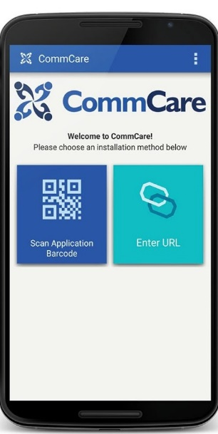



Digital Data Collection…TOOLS
Available tools & platforms

Slide 44

Digital Data Collection…ODK
Open Data Kit (ODK)
Open source
Simple programming
Works with low resource
Low-cost server services
User friendly app
Widely used
Free support service
ODK Build, Collect & Aggregate

Slide 45
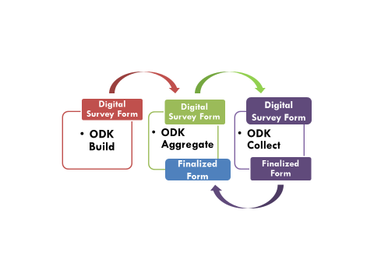
ODK…COMPONENTS
Operation

Slide 46
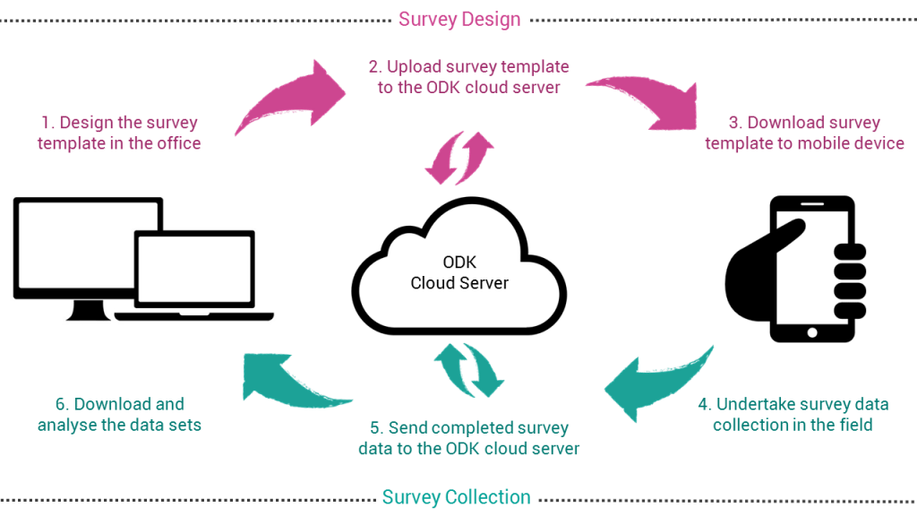
The process
Source: https://geogear.wordpress.com

Slide 47
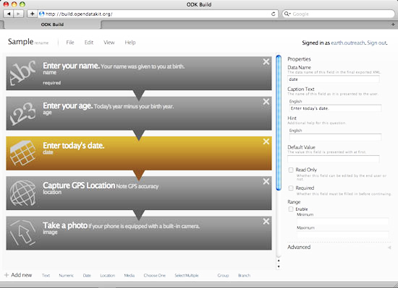
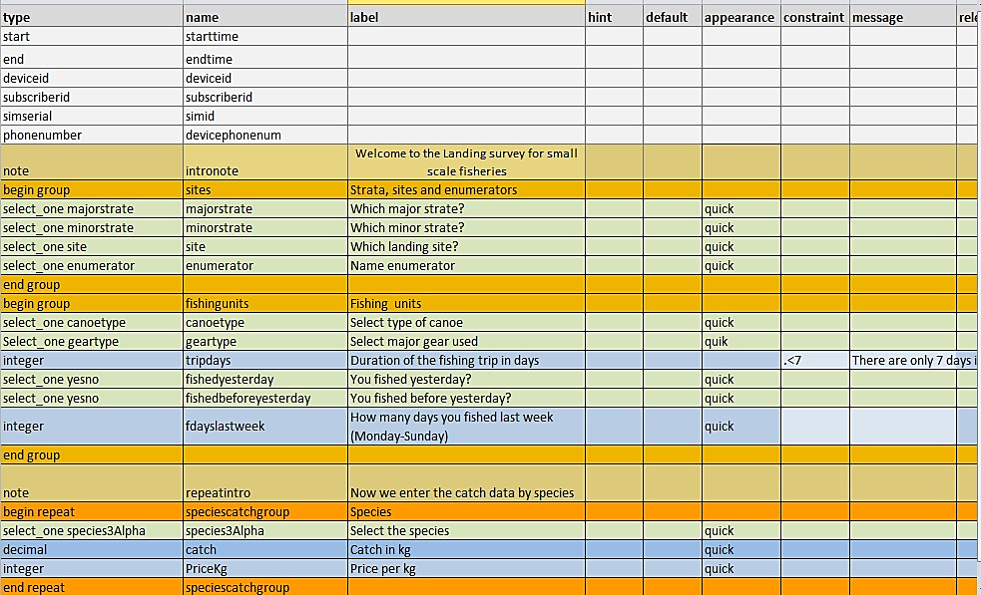
ODK Build
Digital questionnaire can also be programmed using simple MS Excel.

Slide 48
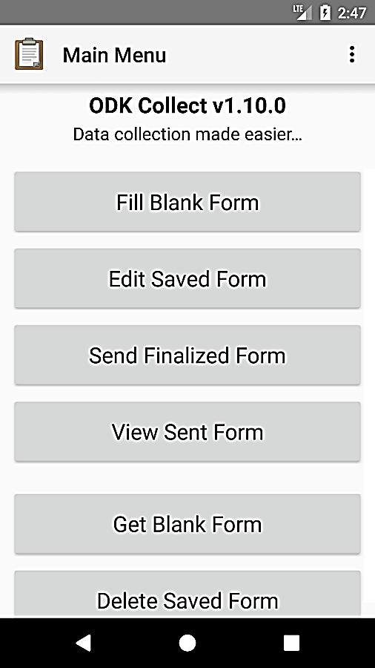
ODK Collect
Data collection app on your device

Slide 49
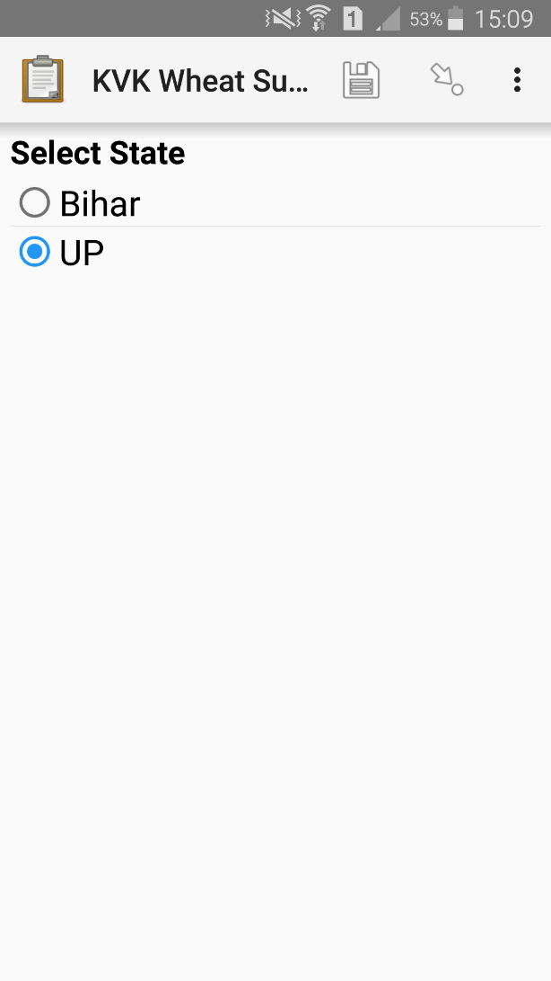
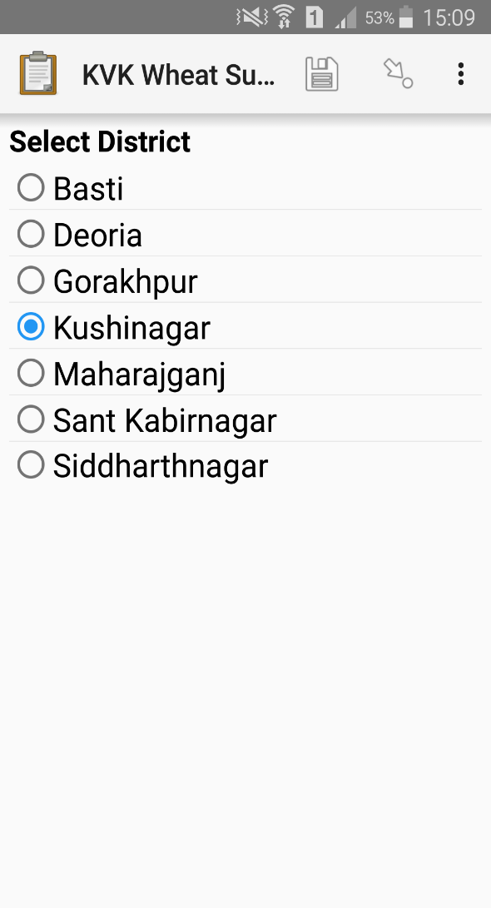
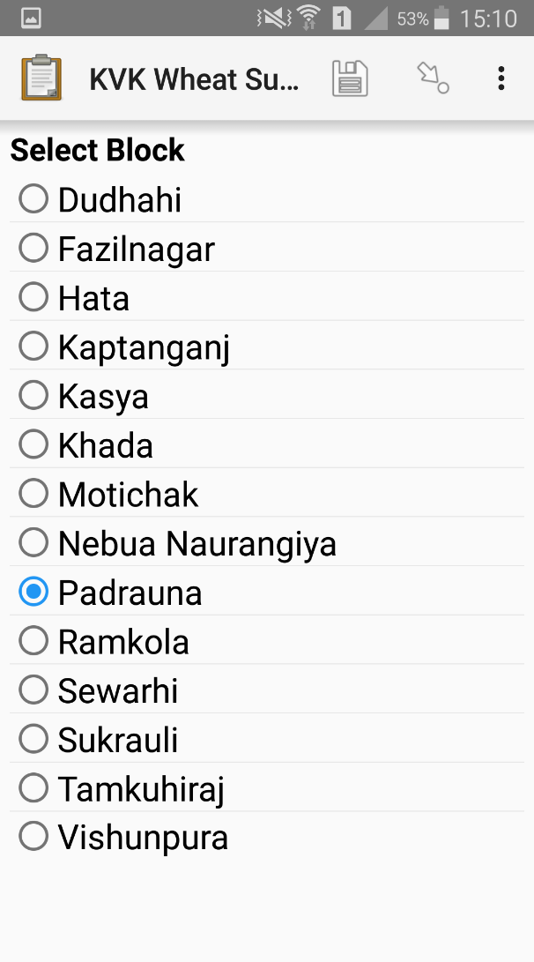
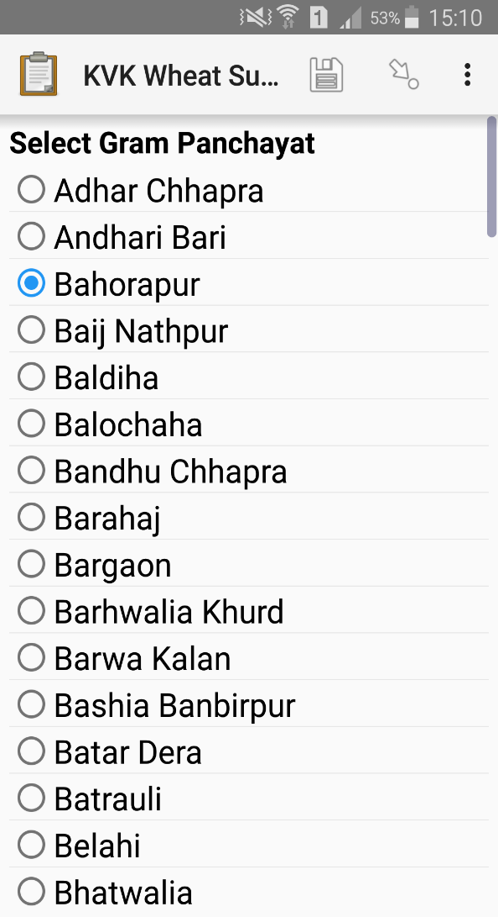
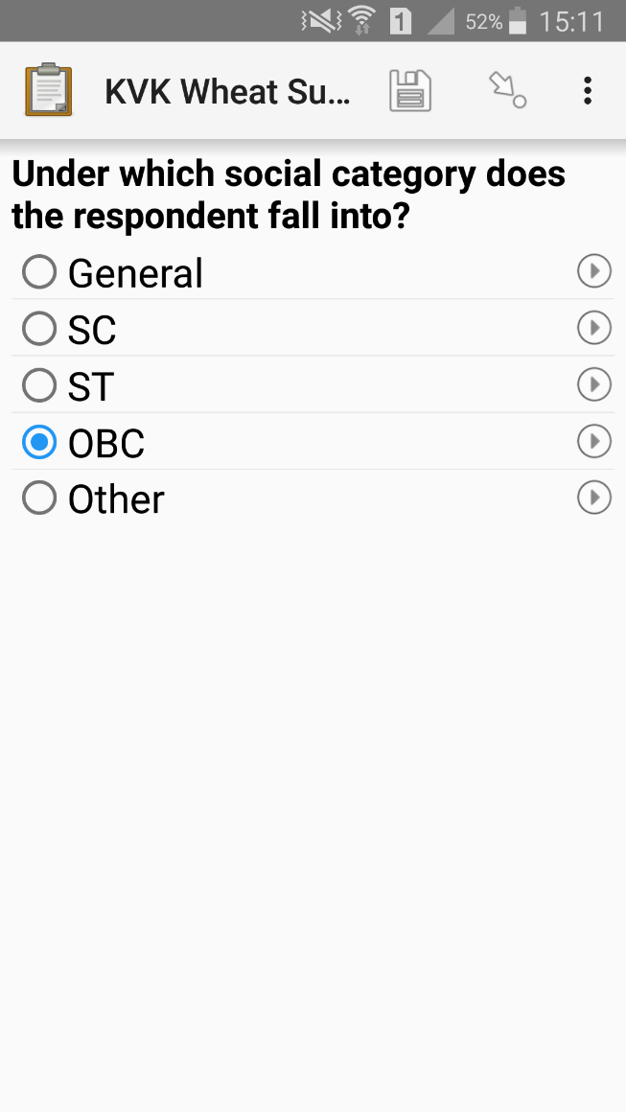
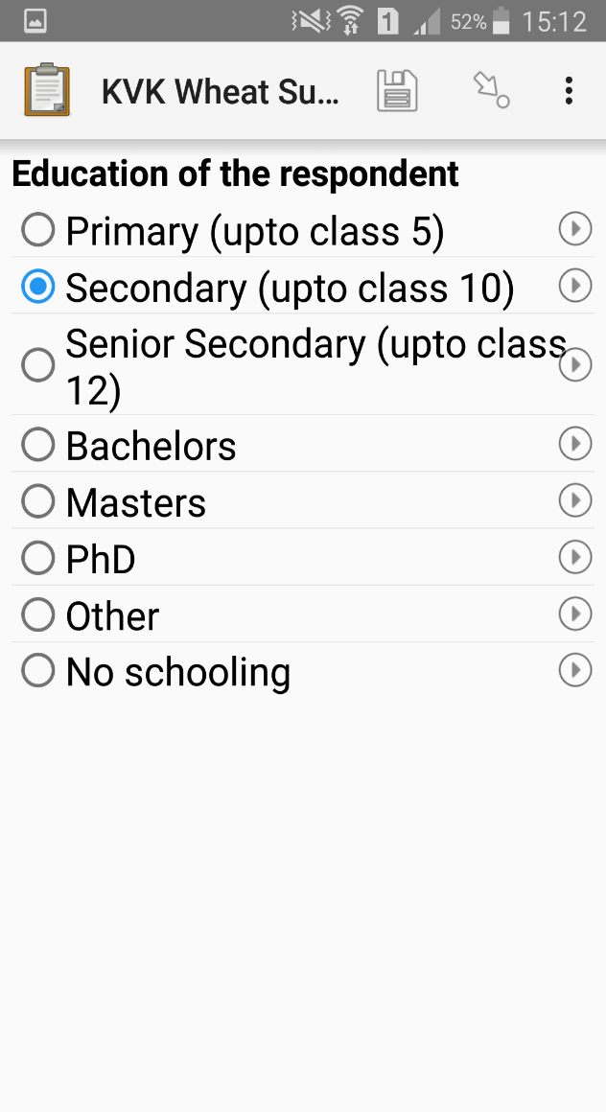

Slide 50
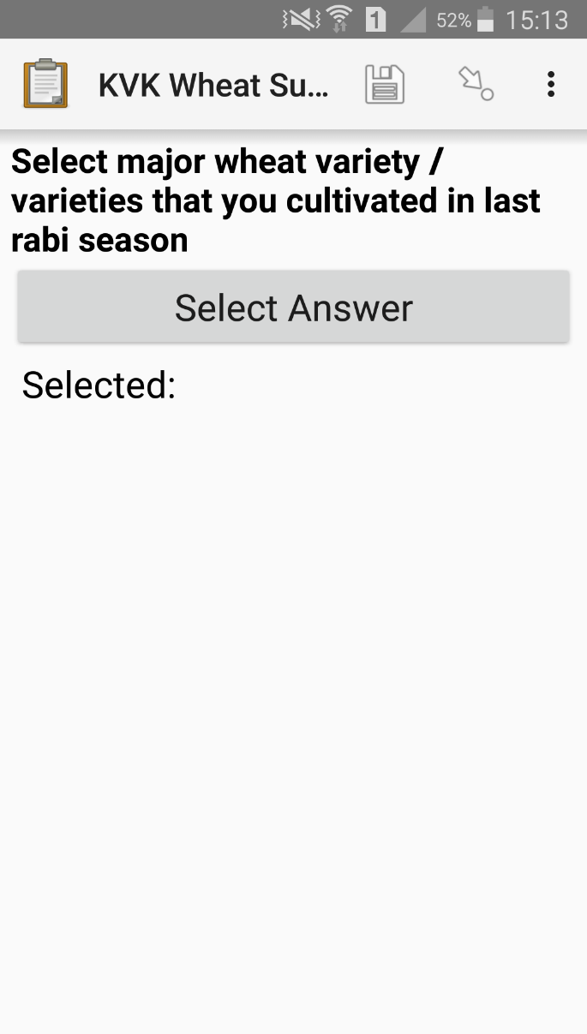
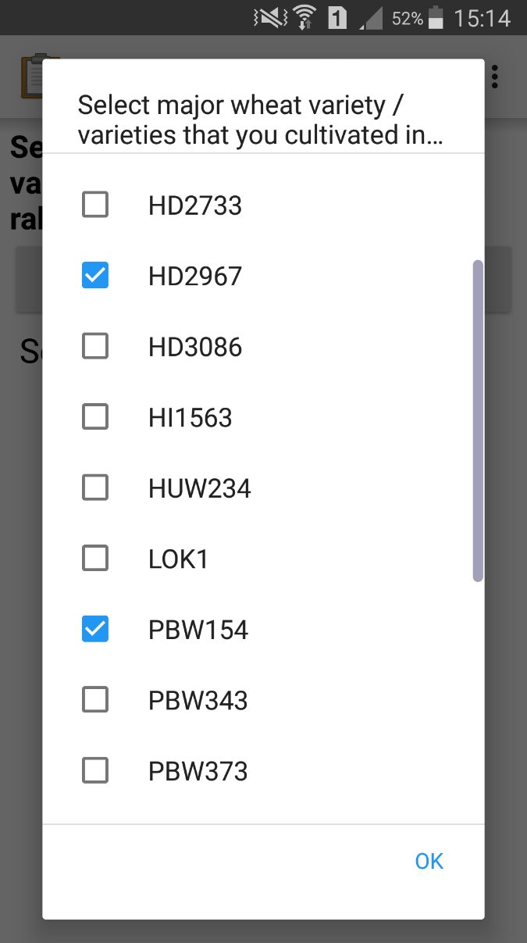
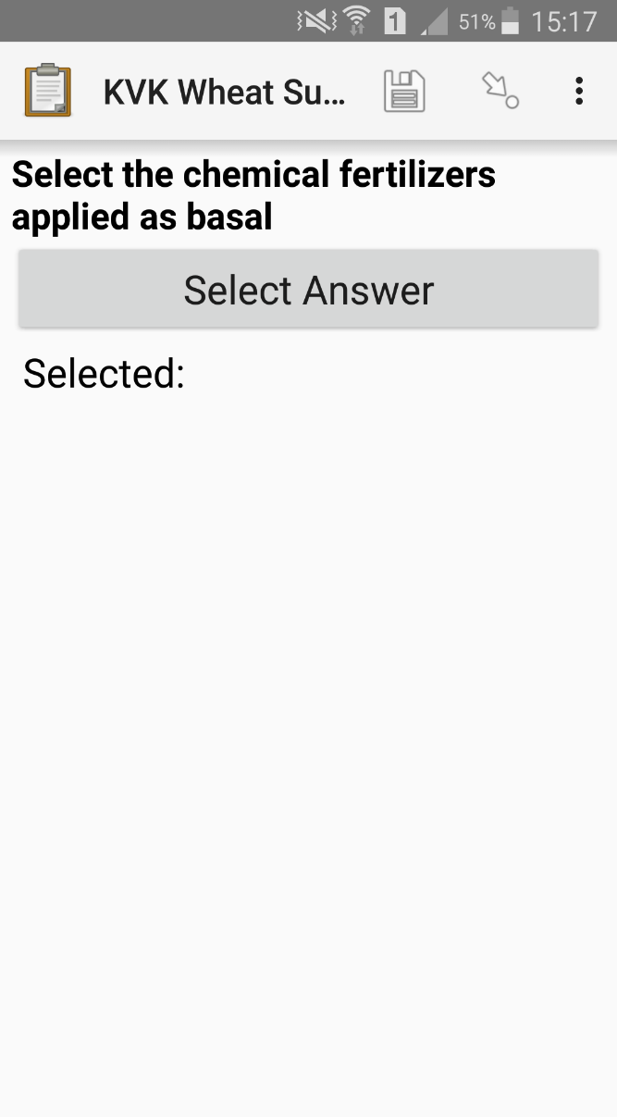
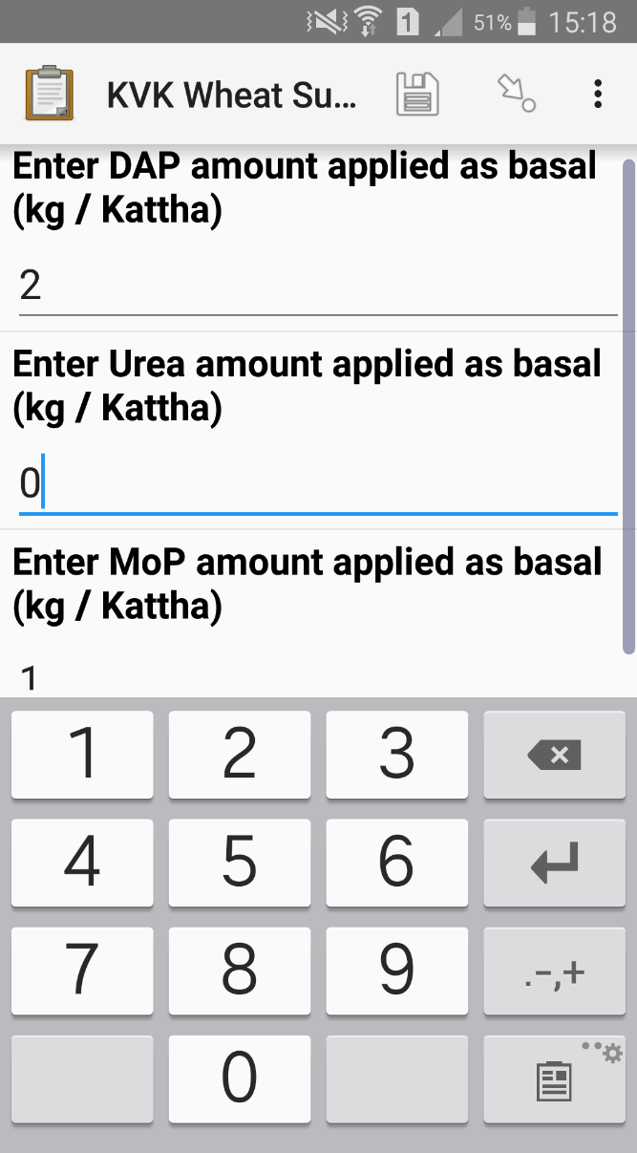
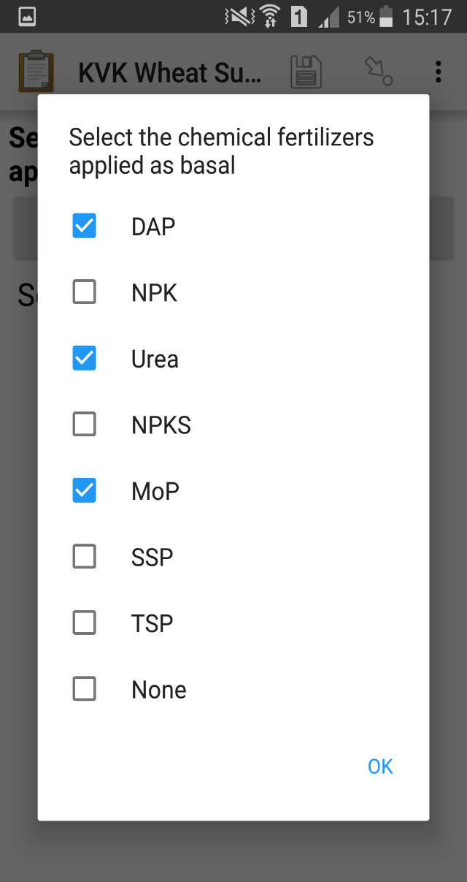

Slide 51
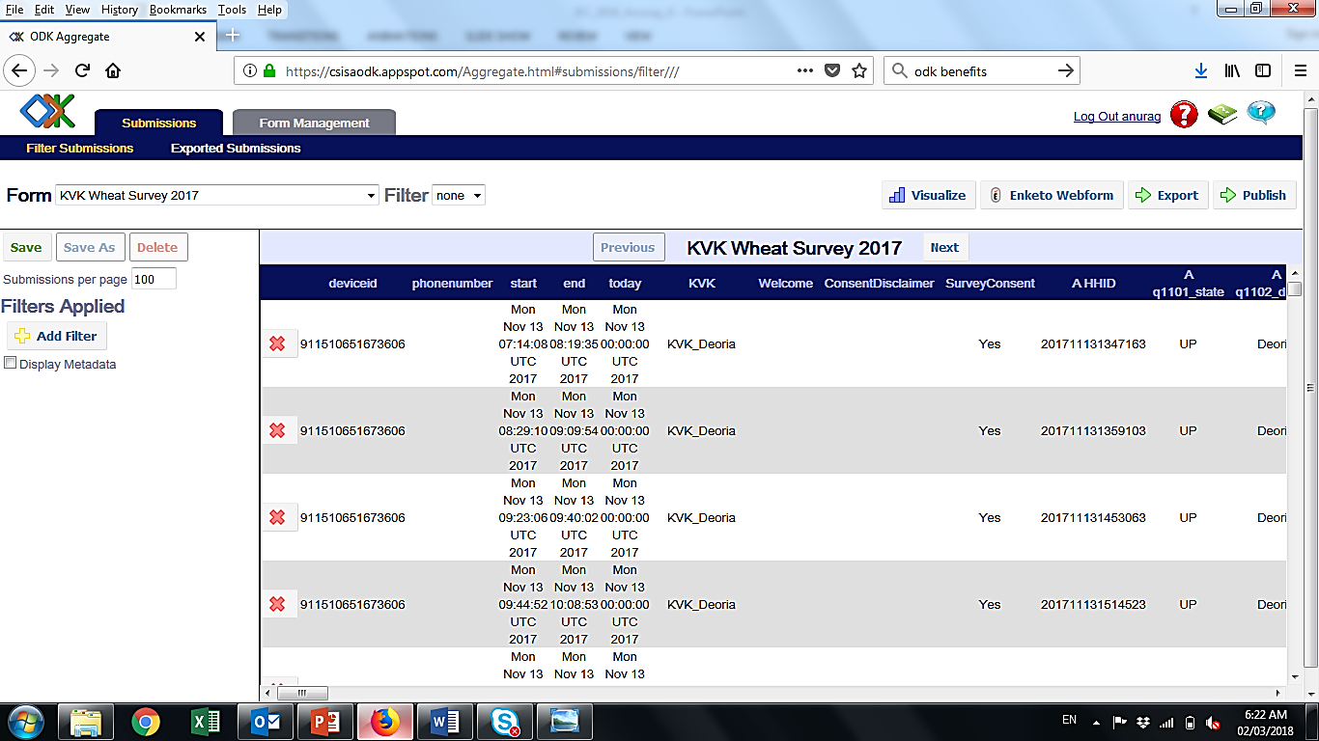
ODK Aggregate

Slide 52
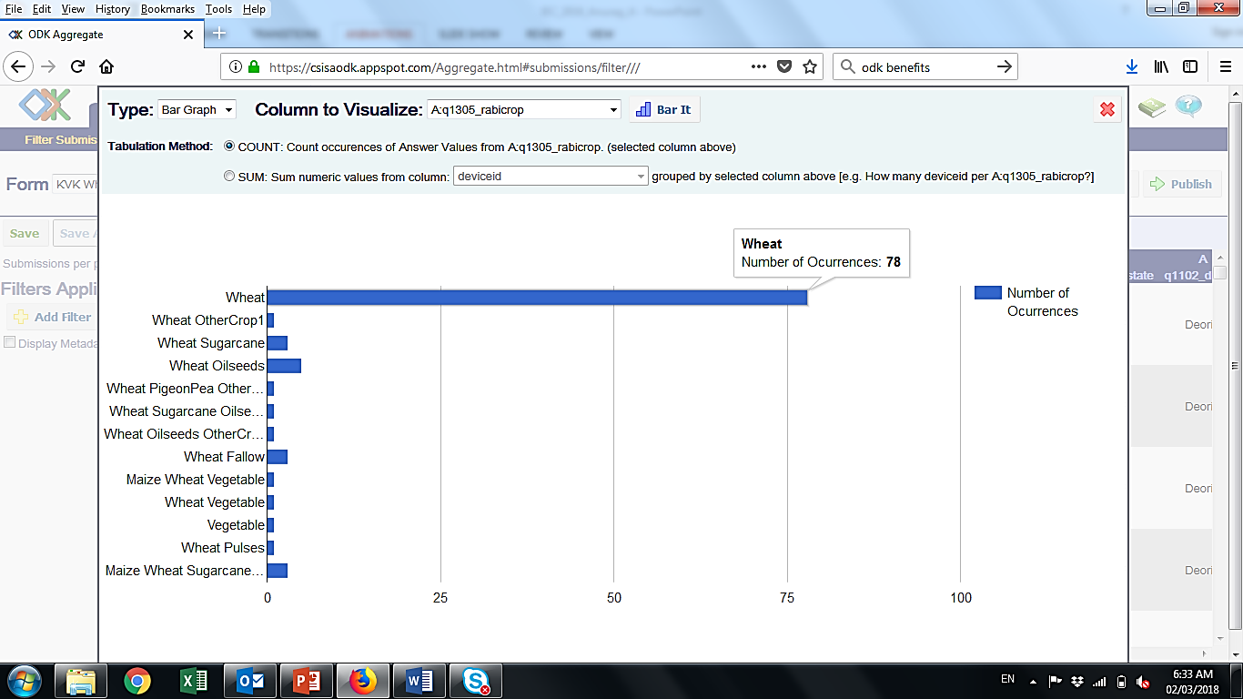
ODK Aggregate

Slide 53
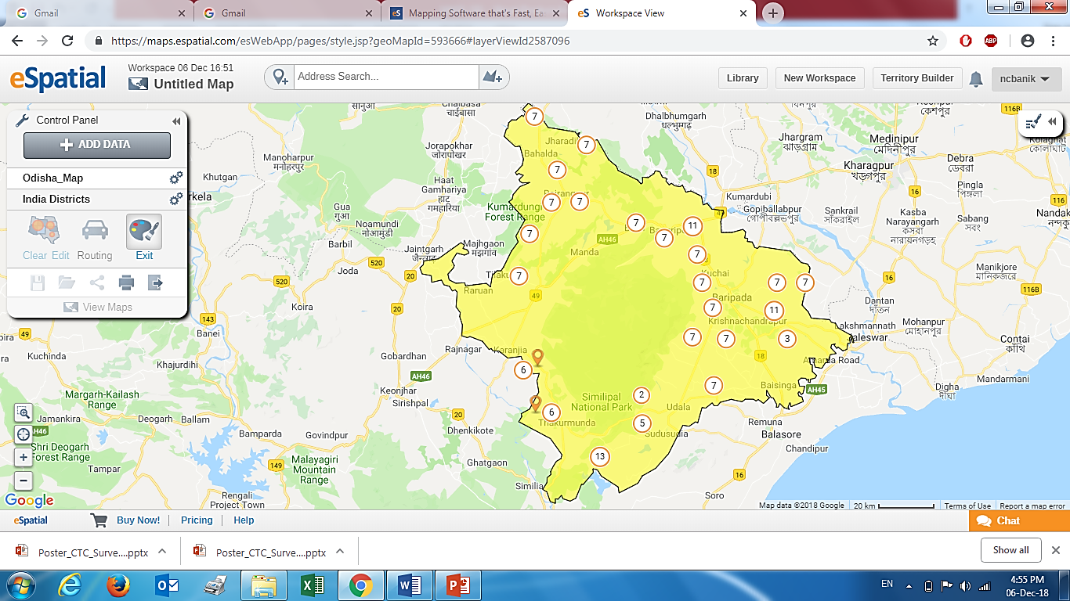
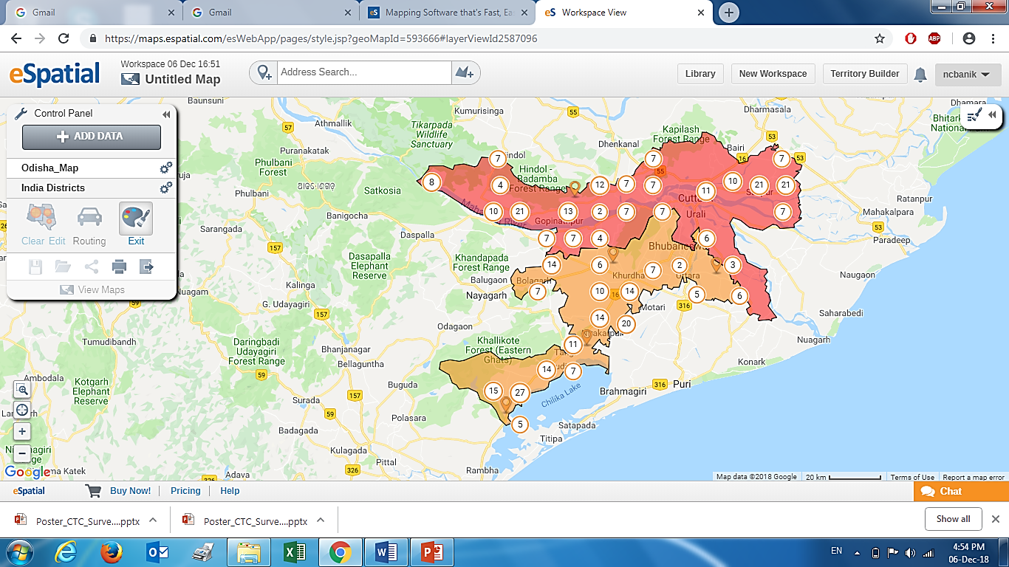
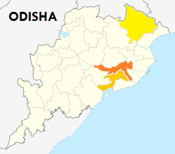
Geo-tagged Locations Of Survey
Survey completed by three KVKs in Odisha for kharif 2018:
Mayurbhanj
DISTRICTS | # Farmers Surveyed
Cuttack | 210
Khorda | 195
Mayurbhanj | 178
Cuttack
Khorda

Slide 54
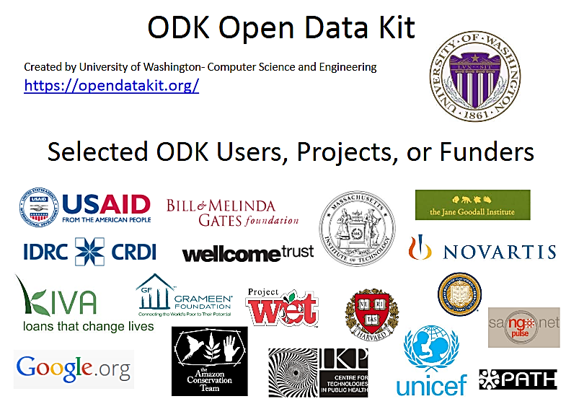
ODK Users

Slide 55
Production Practices Survey
Digital Questionnaire
Rice

Slide 56
Production Practices Survey
Survey Methodology
Data Collection
Data Analytics

Slide 57
Rice Establishment Methods
Broadcasting or ‘Broadcasting + Beushening’ both are very low yielders. Still, 37% farmers are practicing.
???

Slide 58
Varietal Use Pattern
Only two varieties are preferred by 50% farmers.

Slide 59
Problematic Weeds Top 5 in Cuttack & Khorda
10% farmers reported using herbicides & most of them (60% of users) apply pre-emergence mainly Pretilachlor. Rest 40% of the users depend on 2,4 – D.
All farmers perform manual weeding. Most of them (51%) go for 2 times.

Slide 60
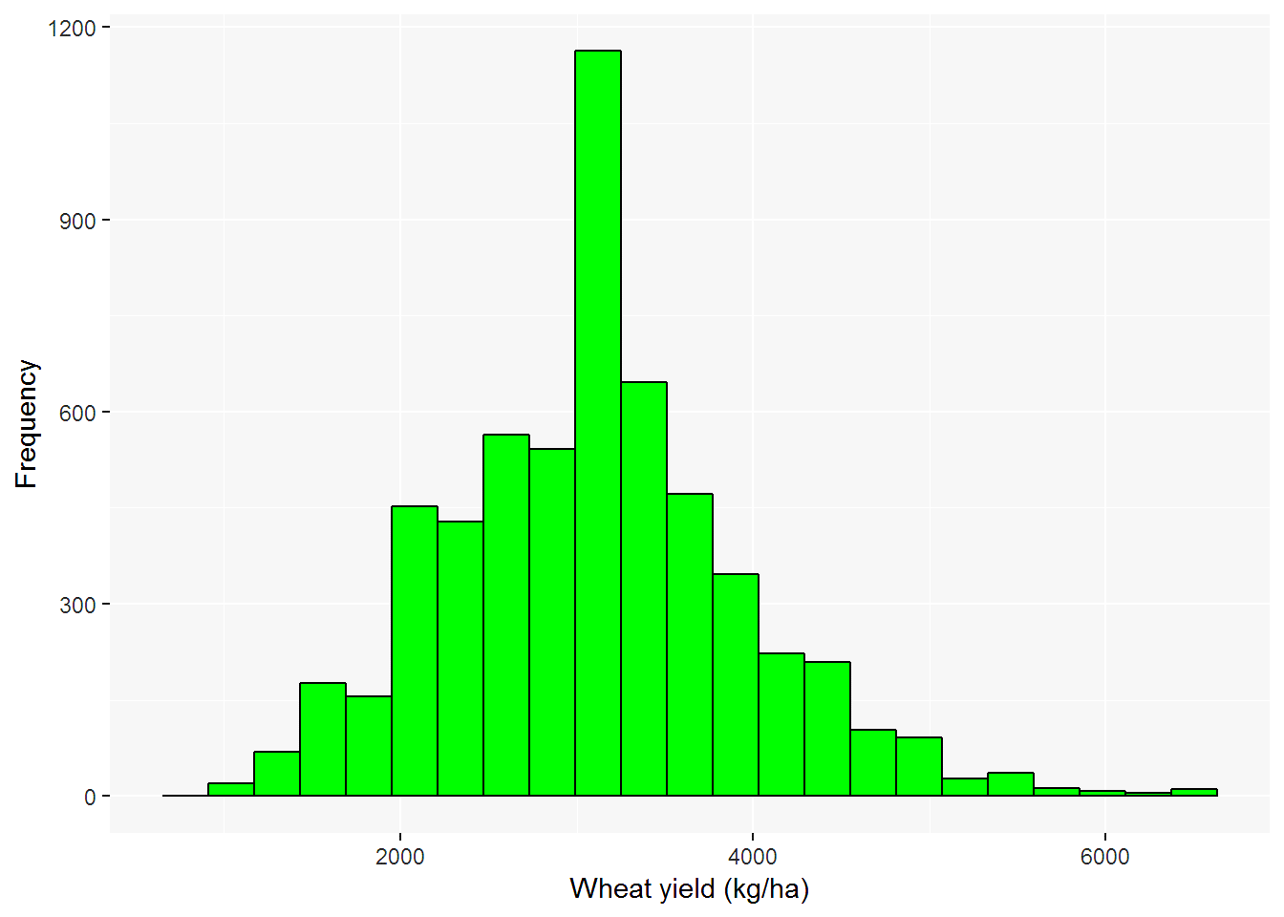
Analysis in R Wheat (N=3286)

Slide 61
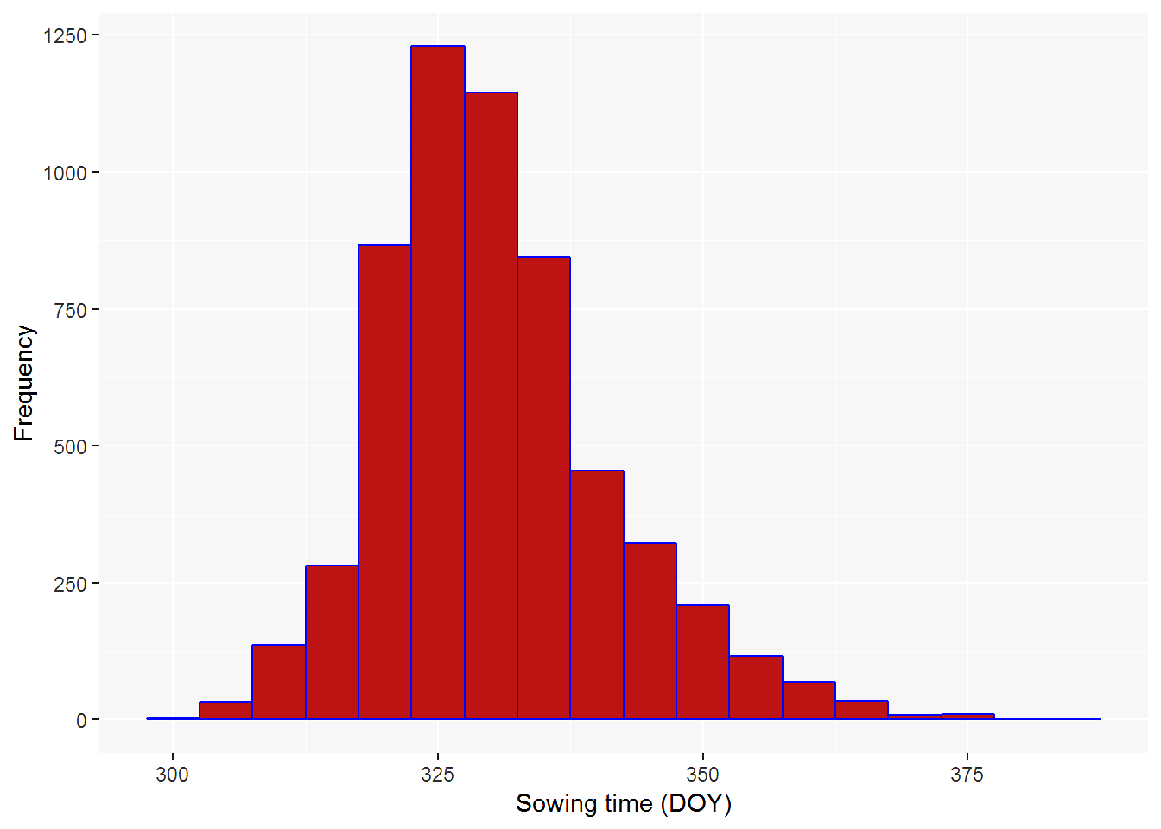
Analysis in R Wheat (N=3286)

Slide 62
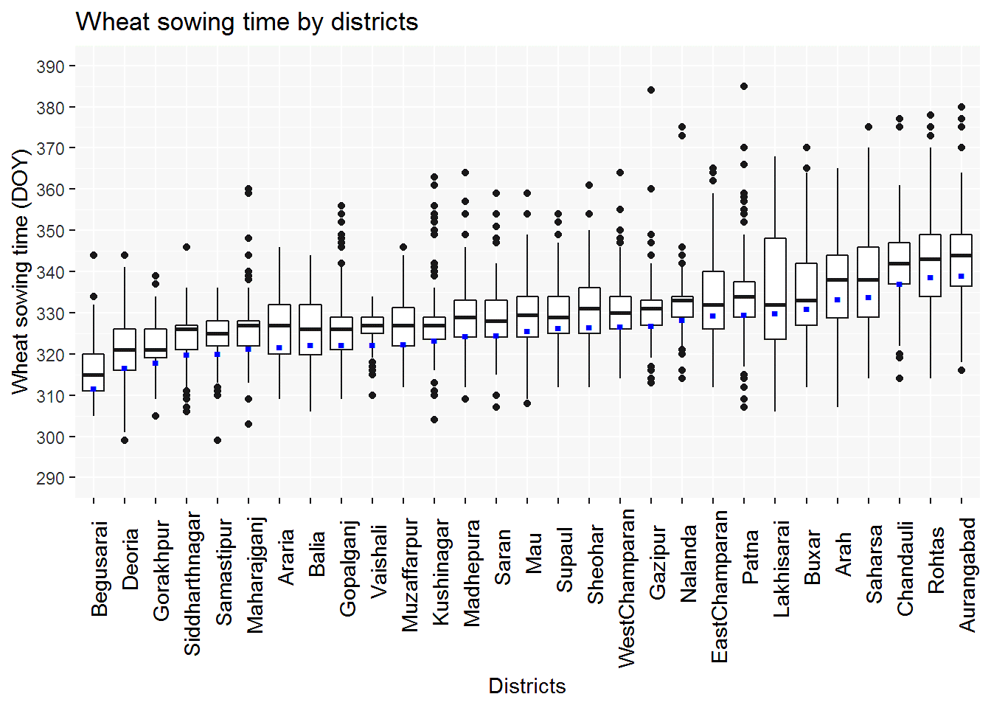
Analysis in R Wheat (N=3286)

Slide 63
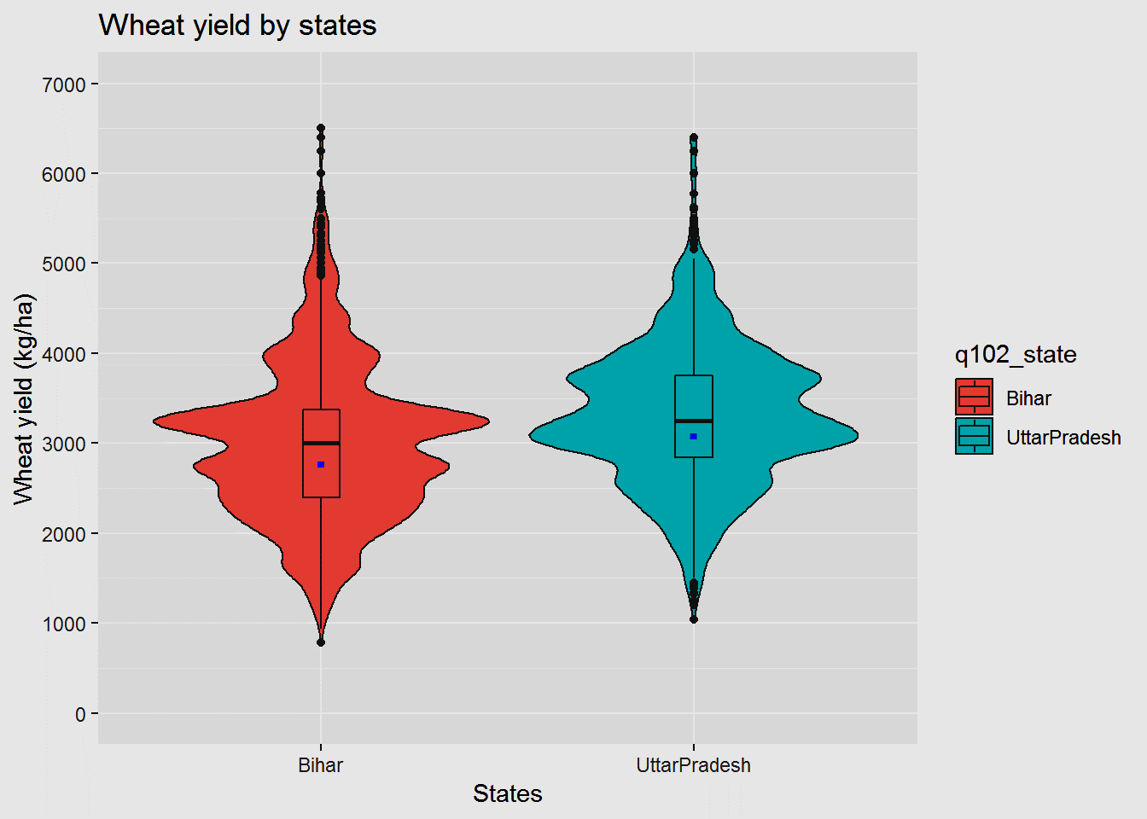
Analysis in R Wheat (N=3286)

Slide 64
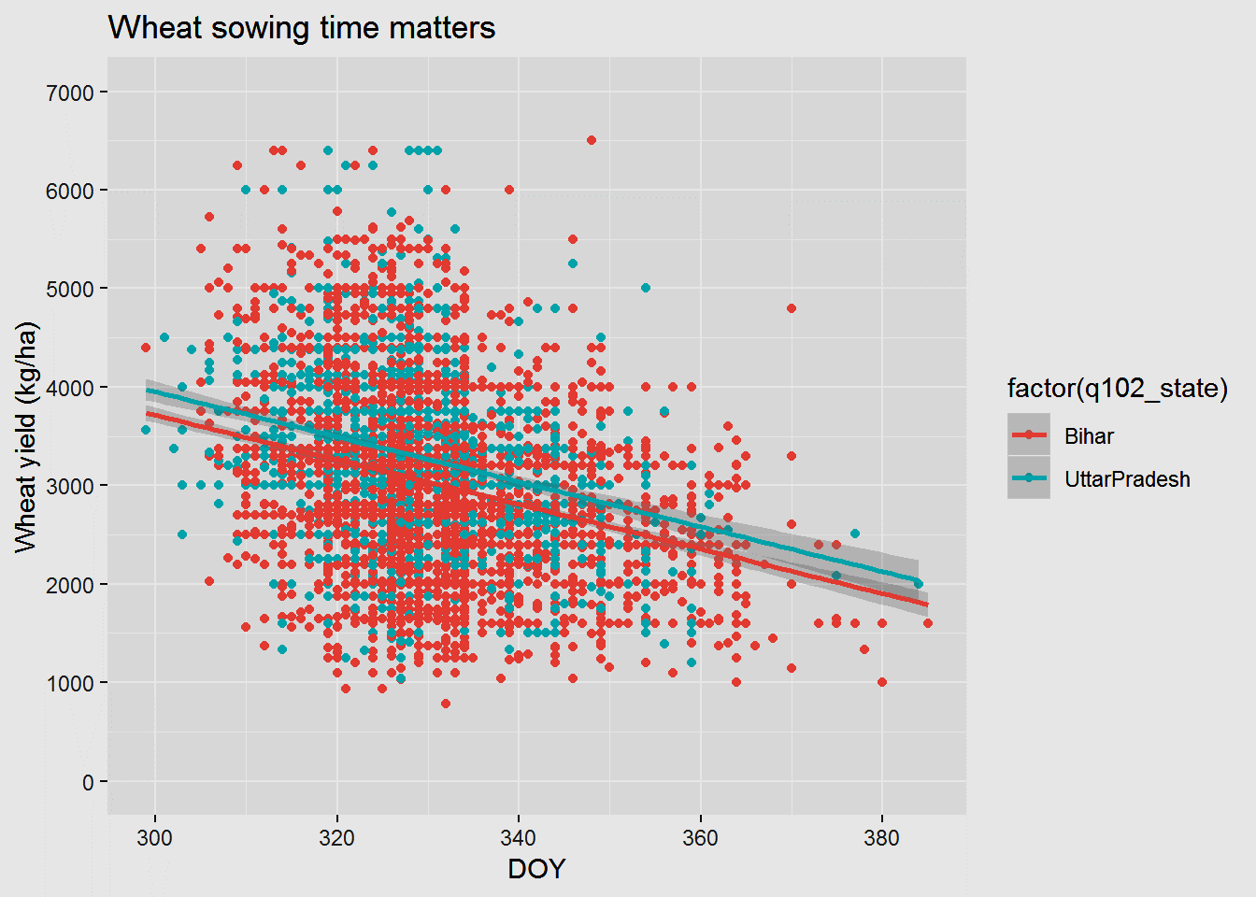
Analysis in R Wheat (N=3286)

Slide 65
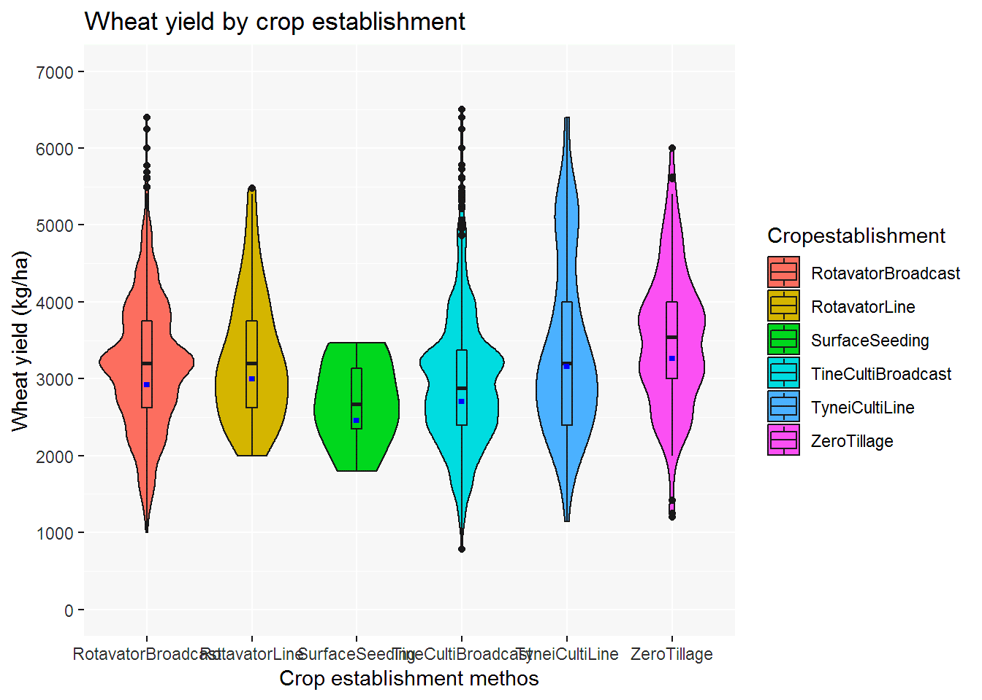
Analysis in R Wheat (N=3286)

Slide 66
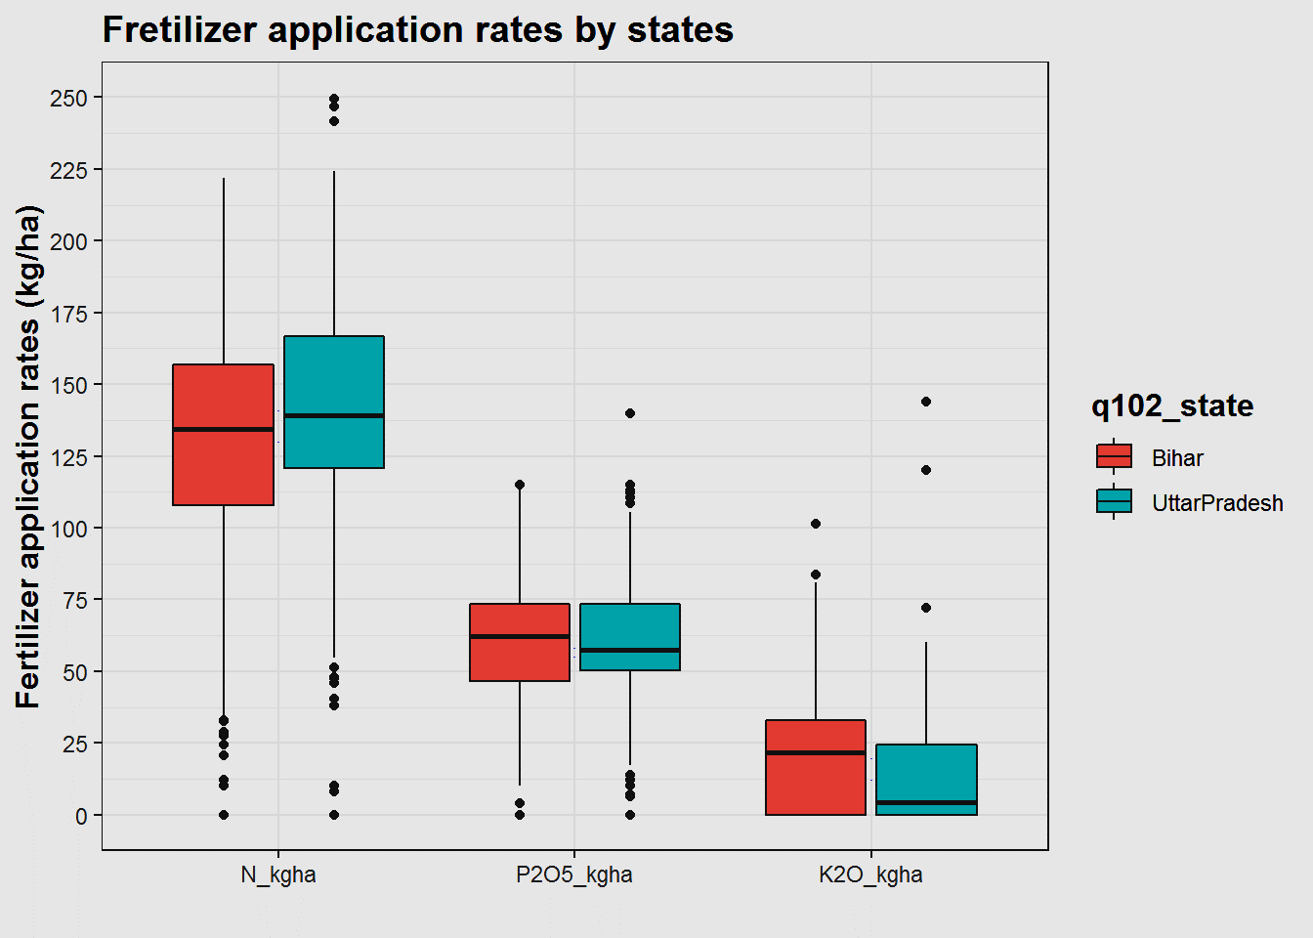
Analysis in R Wheat (N=3286)

Slide 67
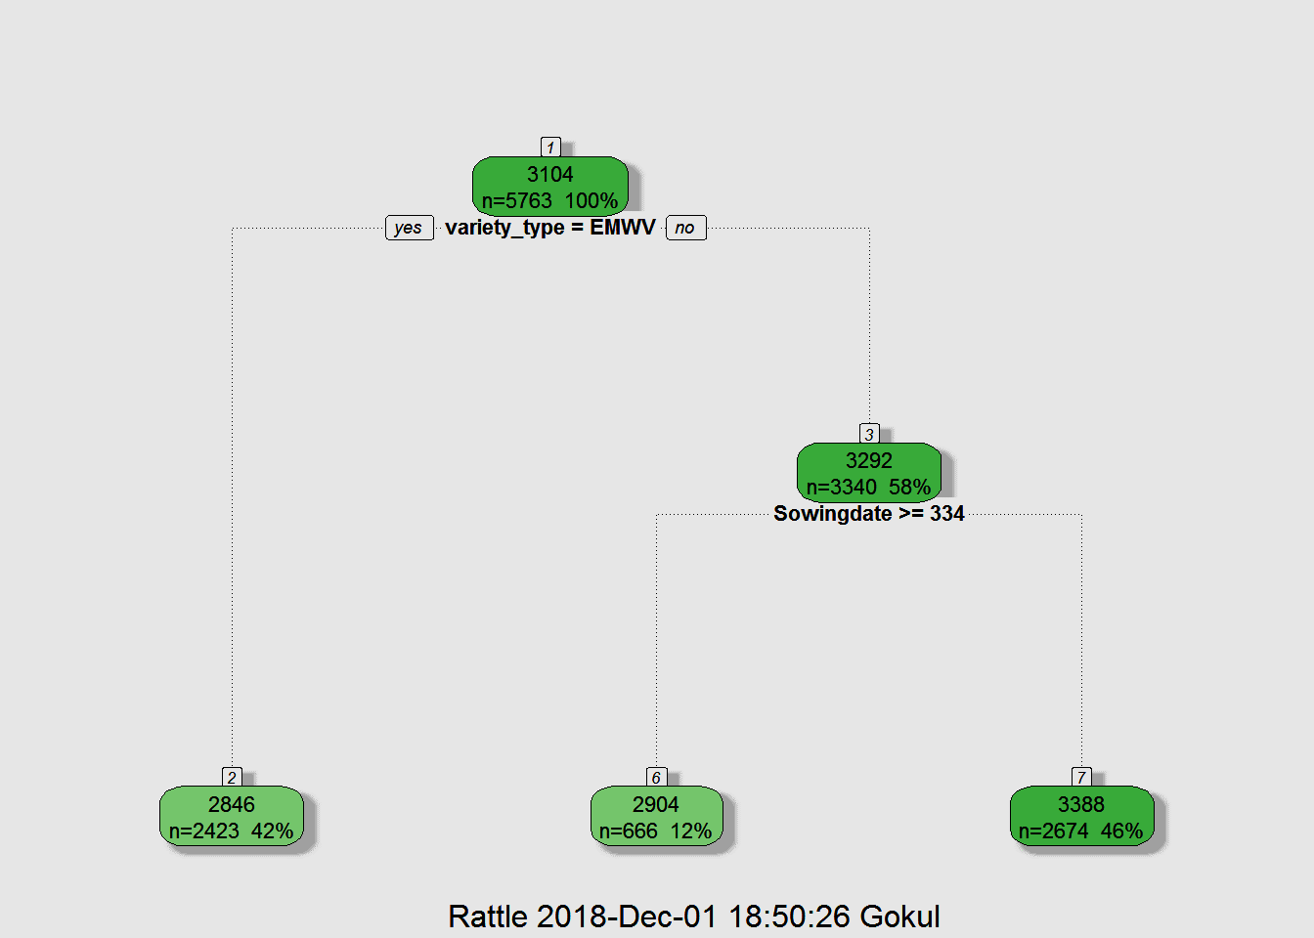
Analysis in R Wheat (N=3286)

Slide 68
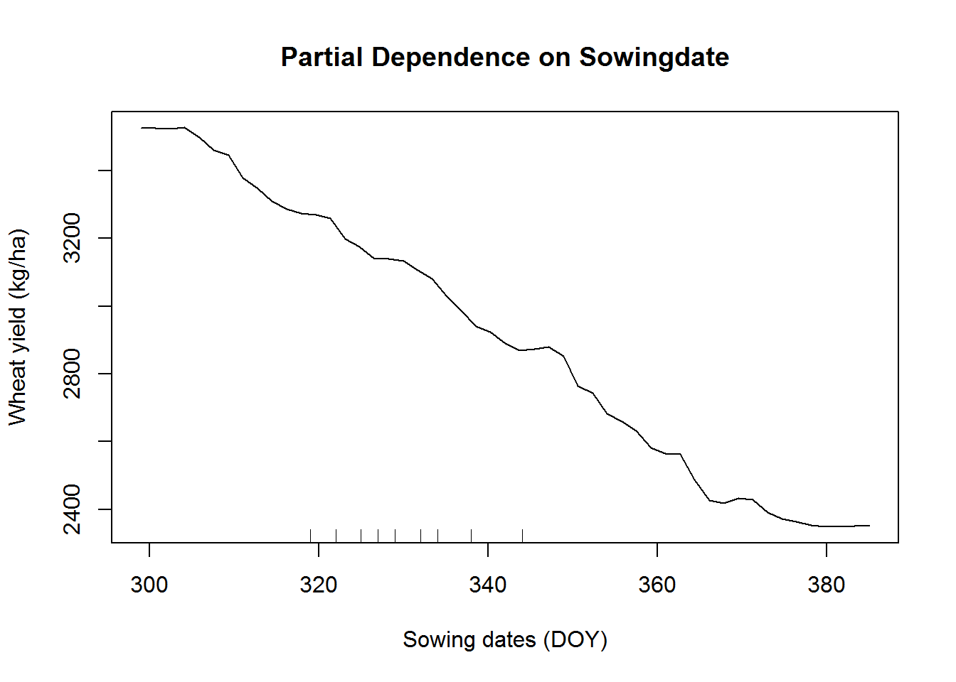
Analysis in R Wheat (N=3286)

Slide 69
www.csisa.org
a.ajay@cigar.org
a.samaddar@irri.org
a.rai@cigar.org
sachin.sharma@cigar.org

